Slide 1
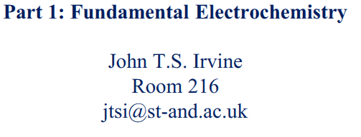
CH5715 Energy Conversion and Storage
http://jtsigroup.wp.st-andrews.ac.uk/ch5715-energy-conversion-and-storage/

Slide 2
Impedance Spectroscopy
Introduction to EIS and process speciation

Slide 3
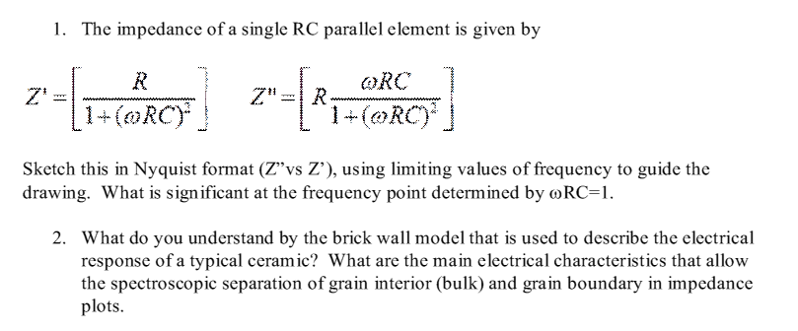
Questions

Slide 4
Electrode Processes

Slide 5
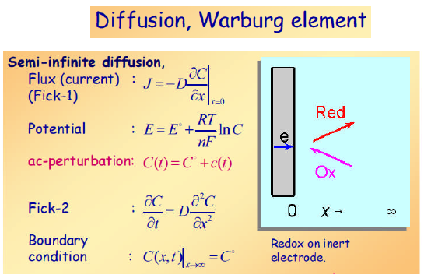

Slide 6
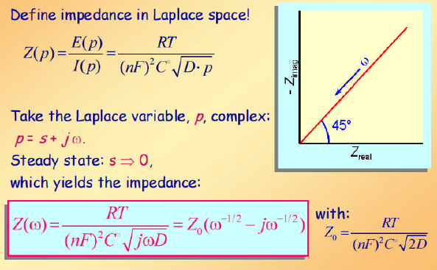

Slide 7
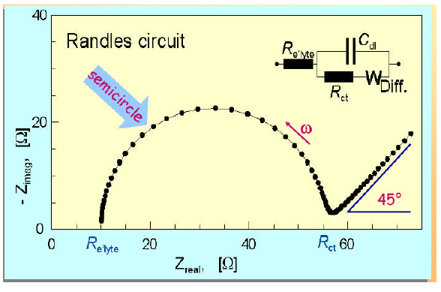

Slide 8
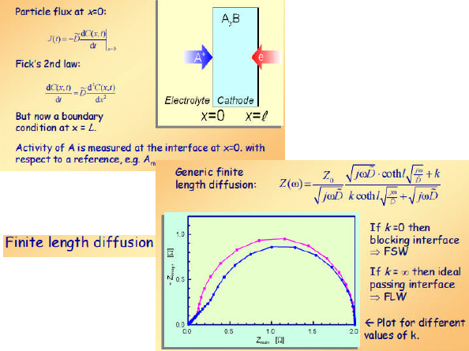

Slide 9

Investigation of role of microstructure in fuel oxidation performance
Patrick Muhl
Electrolyte
Anode
Cathode
ACC
CCC
H₂0
air
H₂
N₂
Introduction

Slide 10
Why do we care about diffusion/ concentration/ utilization - “losses” at the anode?
1. Even though they are mostly small, they are losses!
2. These losses are suspected to increase when using CH₄!
3. Vital in the anode supported FC design!
Approach

Slide 11
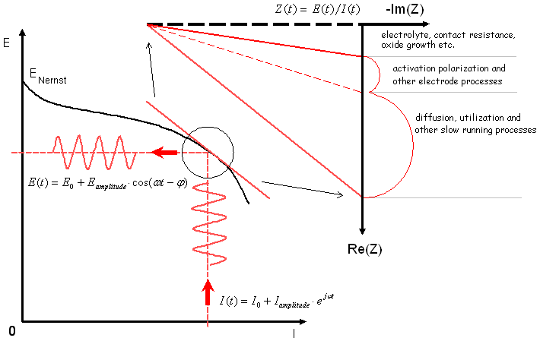
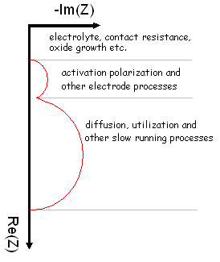
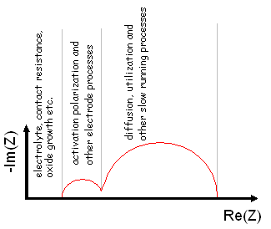
Patrick Muhl
R_{total}
R_{s}
R_{p1}
R_{p2}
Approach

Slide 12
Patrick Muhl
Material properties
Thickness (diffusion length)
Porosity
Tortuosity
Density
Grain size
t_{acc} >> t_{anode} , t_{electrolyte}
Total current ≠ 0
H₂0
H₂0 (CO, CO₂) enriched reaction zone
Gas properties
Diffusion coefficient
Binary or multiple molecules
Competition of H₂ “getting in”, versus
H₂0 (CO₂) “getting out”
fuel
Operation setup
Mass flows (i.e. m_{H2})
Temperature
Current density
.
Introduction

Slide 13
Solid Oxide Fuel Cells: Cathode Materials and Interfacial Reactions

Slide 14
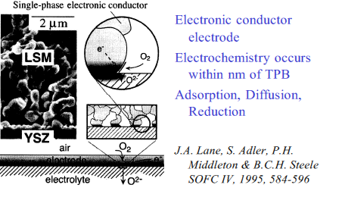
Nature of Three Phase Boundary

Slide 15
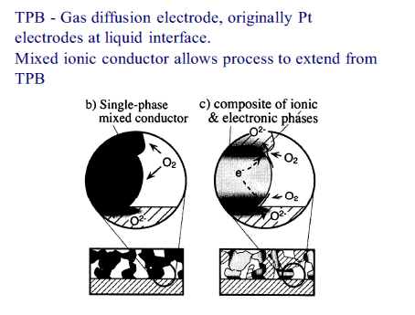

Slide 16
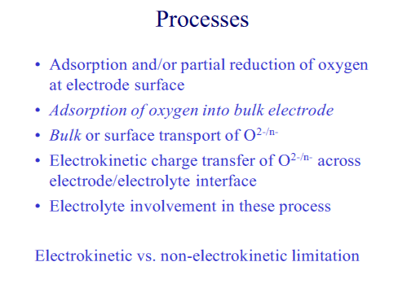
Charge transfer

Slide 17
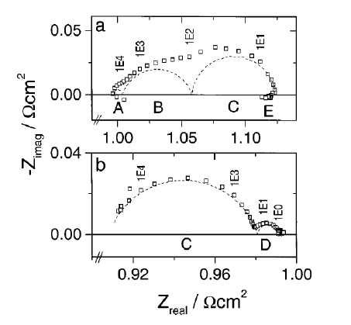

Slide 18
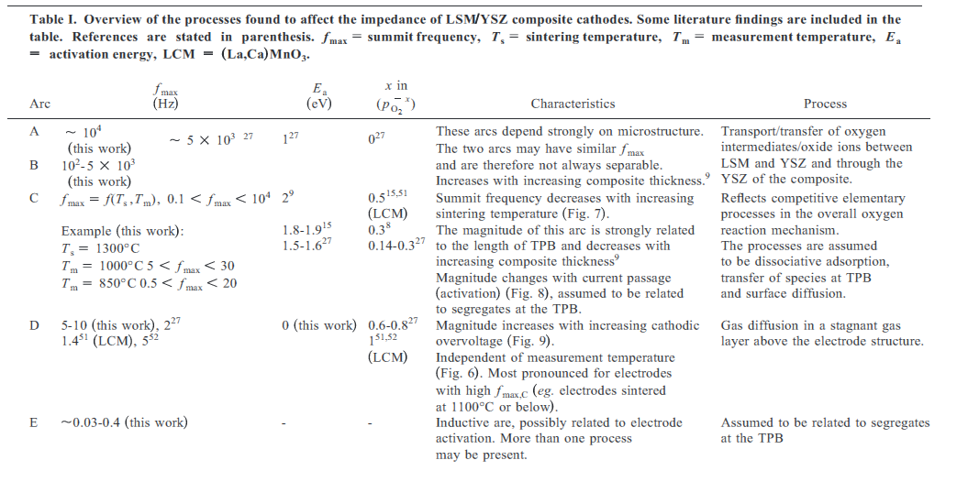

Slide 19
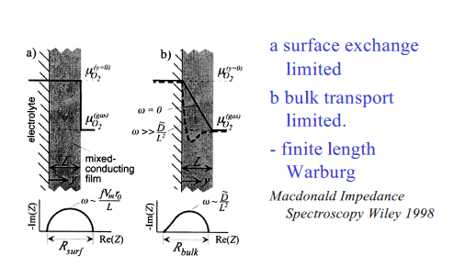

Slide 20
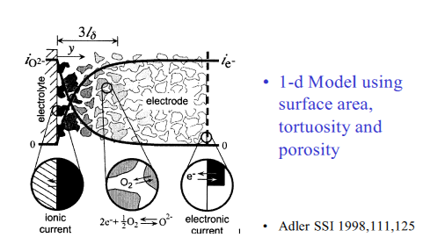

Slide 21
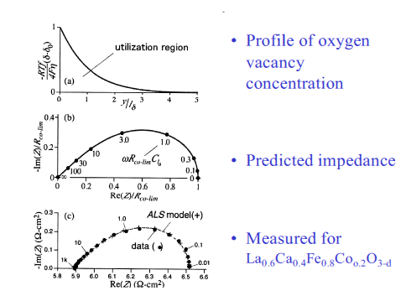

Slide 22
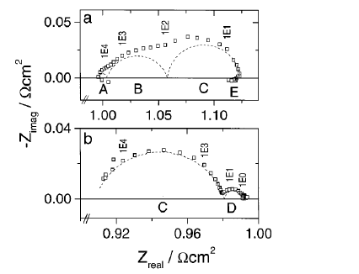

Slide 23
kHz
Charge transfer
Hz
Diffusion

Slide 24
Resume of impedance – process relations
Electrolyte
Electrode
CC
O
R
Ion and electron
Transport
R/C
Mass transport
Warburg types
Charge transfer
Polarisation
R/C

